Slide 1

Welcome
Key Stage 4 Options
Parents Information Evening

Slide 2
Welcome from Mrs Nicol
An important and hugely exciting time – the first time students and home take charge of subject choices.
Be reassured by our experience in giving guidance and advice
It may seem too early now – not by the end of the year!
This evening, the booklet and website are starting points for advice – where else?
Try to look forward – and choose to support these routes.
Try to rule out as few pathways as possible. Broad and balanced.
Don’t worry if you don’t know – or keep changing your mind.

Slide 3
Aims of this presentation
To introduce ourselves
To detail national changes affecting Key Stage 4 option choices
To make the option choices available to students clear
To offer some advice on making decisions
To make sure you know who can help
To make the key dates clear

Slide 4
The new GCSE grading system
The GCSE grading system of A*-C has been replaced by a 9-1 scale
English and Maths were awarded the new 1-9 grades for the first time in Summer 2017.
All of your children's GCSE grades will be in the new 1-9 system

Slide 5
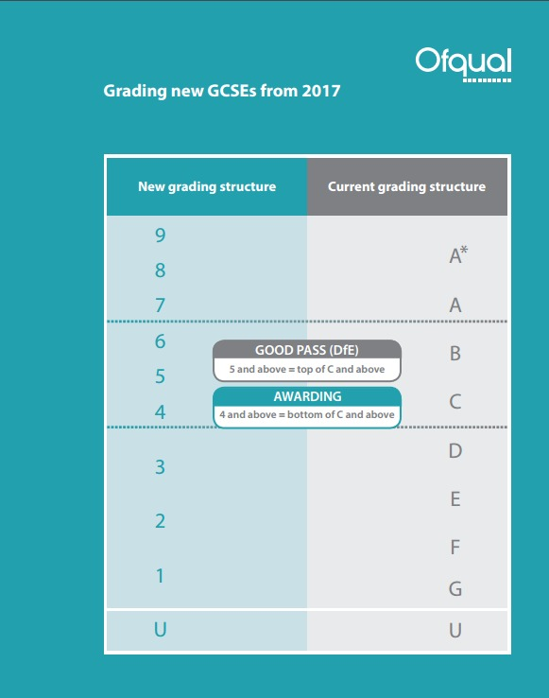

The new GCSE grading system

Slide 6
Department for Education Advice
The DfE has acted on research suggesting
  some subjects are better at facilitating more career choices than others.
  Some subjects help learning in other subjects better than others
  Some subjects aid brain development better than others
It calls theses subjects the English Baccalaureate or EBacc subjects.
It wants 90% of students to be taking the EBacc subjects by exam year 2025.

Slide 7
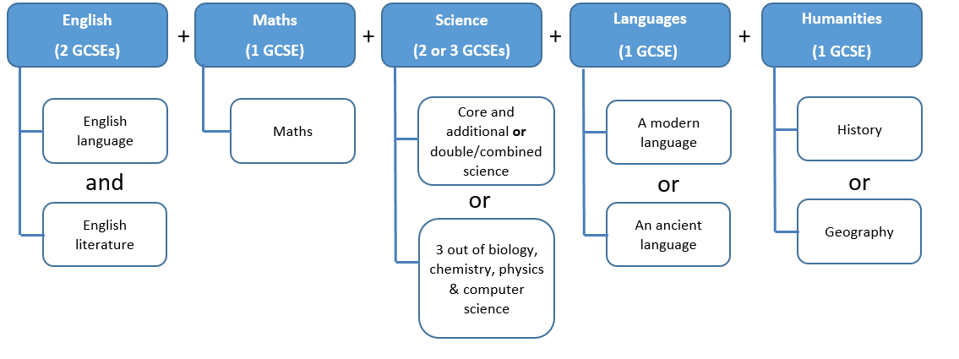
What are the EBacc subjects?
To fulfil the EBacc requirements students need to do these subjects.

Slide 8
The SGS Key Stage 4 Curriculum
The Key Stage 4 curriculum has compulsory core subjects as well as guided options and free choice options.
Most subjects we offer are GCSEs
Health and Social Care and Business Studies are offered as BTECs
We also offer a Cambridge National in Creative iMedia and Sports Studies
Some students may be advised by the SENCO to consider the ASDAN course or Literacy and Numeracy Support

Slide 9
The core curriculum - compulsory subjects
Compulsory GCSE Exam Courses
English Language GCSE English Literature GCSE Mathematics GCSE Science GCSEs Religious Education (half GCSE)
Compulsory non-exam courses
Personal Social and Health Education Physical Education

Slide 10
Science courses
Every student will study at least the Combined Science Double GCSE course.
  A single qualification equivalent to 2 GCSEs
Students may choose to do Separate Sciences GCSEs by choosing this as a free choice option.
  1 GCSE in Biology, 1 in Chemistry and 1 in Physics

Slide 11
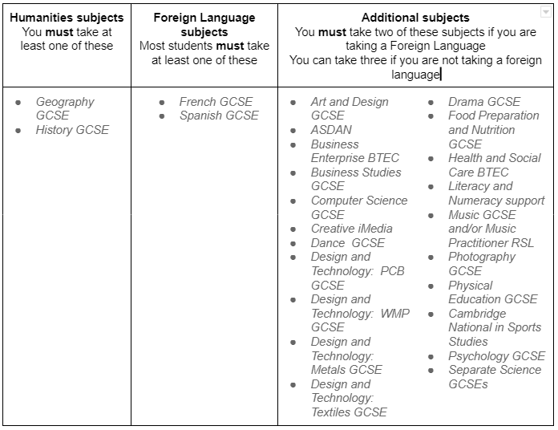
The options – 2 free choices, 2 guided choices
Notes:
Note: drama % the wrong way round in booklet – should be 70% theory

Slide 12
Why do we ask all students do a Humanity?
All students have to do either History or Geography.
Students can take both if they want to - choose the second one as a free choice.
We believe the skills and knowledge built by studying a humanity are essential for all students.
  An understanding of the world and our place in it
  An ability to make constructive argument
  An ability to critically analyse qualitative evidence

Slide 13
Why do we ask most students do a foreign language?
Most students have to study a foreign language.
Students can take more than one if they want to - choose the second one as a free choice.
Studying languages helps students:
  Develop an understanding of different cultures
  Improve their understanding of language, including English
  Think in an alternative way
Language qualifications are some of the most valued qualifications by colleges and universities.
Jorge
We will not make the 65% number public to parents - this is not in our interests.
We tell parents that learning a language
First and foremost is good for brain development. Learning a language helps students think in a different way in a similar way that students have to learn to think differently in Maths compared to English. This 'exercises' different parts of the brain and helps improve ongoing learning skills.
It is also good for character development. Character is developed through challenge and learning a language is challenging. Going through that challenge with the nurture and support of our excellent languages team helps students realise that difficult challenges can be overcome and helps them develop growth mindset and grit.
Learning a foreign language develops and understanding of language which benefits English - English has the biggest beneficial effect on other subjects and ongoing learning.
Learning a foreign language helps develop understanding of other cultures which is important in our increasingly interconnected world.
Language qualifications are some of the most valued qualifications by colleges and universities.
In most developed countries, most students learn a foreign language until at least the age of 16.
Furthermore the government, after a large and wide ranging review agreed with this view point and has put targets on to schools to increase Foreign Language uptake. In most schools Foreign Languages already occupy part of the curriculum for most students up to age 16. If the government continues with its targets, which it looks as if it will do, not having a Foreign Language GCSE will become unusual.
Andrew

Slide 14
Forbidden combinations
Students cannot study the following combinations.
Computer Science and Creative iMedia
Business Enterprise BTEC and Business Studies GCSE
GCSE PE and Cambridge National Sports Studies
More than one of DT (WMP), DT (PCB) and DT (Textiles)

Slide 15
Choosing options online
Students will receive an email to register with ‘SIMS online’ tomorrow (20th January)
This is not the email they use to login to SIMS online once registered. To login on future occasions they go to https://sts.sims.co.uk/login
They then choose their options by clicking on them on screen.
They can do it on any internet device.
They can change their mind as many times as they like up until the deadline of February 18th.

Slide 16
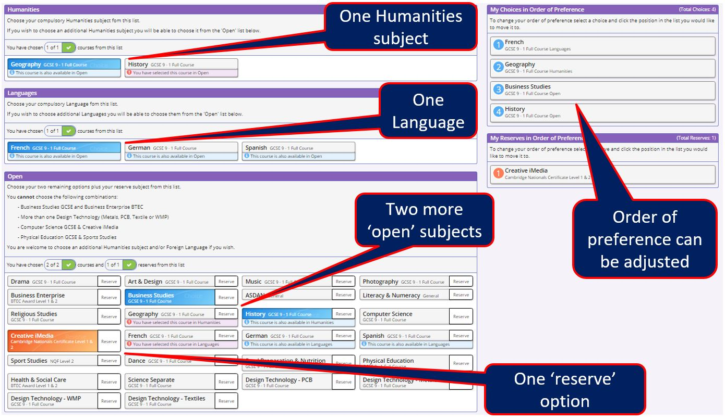
Choosing options online

Slide 17
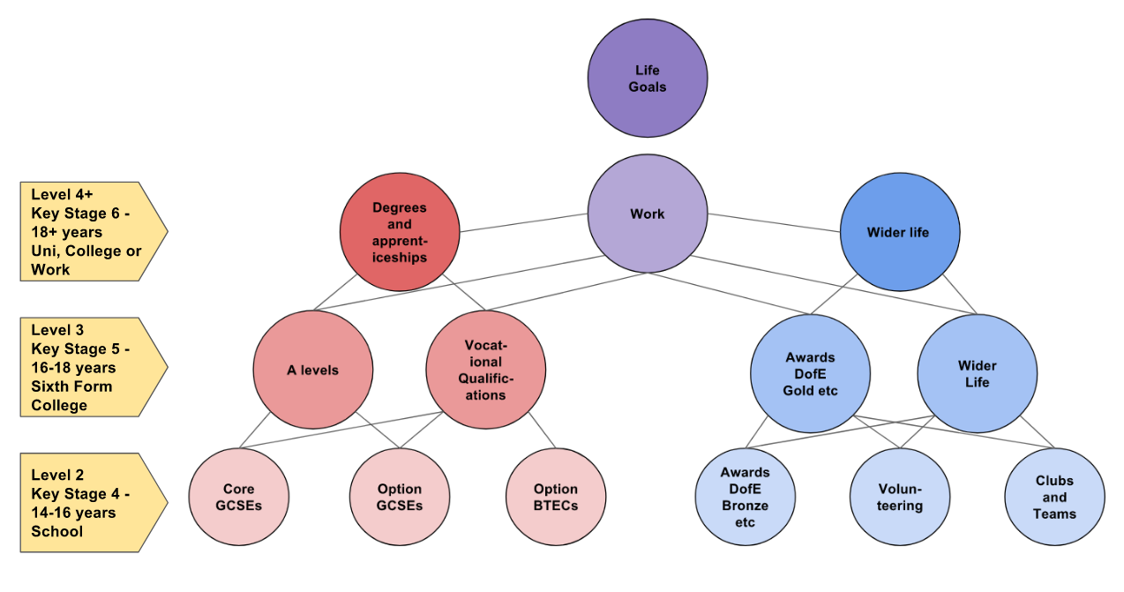
Making Choices

Slide 18

Making Choices
20%
80%
My child has a clear idea about their future plans:
Choose subjects that will support this interest
My child is not sure about future plans:
Choose a range of subjects to keep options open

Slide 19
Making Choices
The chosen subjects will be studied for the next three years. Therefore it is important for your child to consider:
  What your child really loves doing and gets the most enjoyment from?
  Where your child has worked well to master skills so far?
  What style of learning your child learns well from?

Slide 20


Further pathways information
Informed choices lets you know what subject combinations at A-level work for particular degrees.
https://www.informedchoices.ac.uk/
The Apprenticeship Website gives information on the types of apprenticeships available.
https://www.apprenticeships.gov.uk/apprentices#

Slide 21
What happens now
January 20th – students are sent the link to fill out their options to their school email.
February 18th - Deadline for students to complete the online application form.
March 1st – Parents and carers receive a letter with their students initial choices on.
May 20th – a letter confirming choices will be sent home.
Please note that whilst we satisfy over 95% of student first choices it is impossible to always do so.

Slide 22
Questions and help
Please email options queries to awood@sgs.uk.net
Students can talk to their teachers, tutor and REMAP teacher about options
Parents evenings will be run on the w/b 7th and 14th February
Subject information videos: https://sites.google.com/sgs.uk.net/ks4virtualopenevening/home
General options information https://www.sgs.uk.net/key-stage-3/curriculum-overview-ks3/options/
The options booklet details information for all subjects.

Slide 23
What to do now
Now is you and your child’s chance to talk to the teachers in charge of the different subjects on offer and ask questions.
Google Meets are available for every subject.
The links to the Google Meets were sent to you on Monday in our letter
They are best accessed from a student school Google account.
They are in the students calendar - click the event and choose ‘Join with Google Meet’.

