Slide 1










Children and young people online
We will begin shortly
www.thinkuknow.co.uk/parents

Slide 2
Any Questions?
If you have any questions please write them in the comments and we will try to address them at the end of the presentation
Thank you

Slide 3


Parents and Carers (Secondary)
Protect your children from sexual abuse online
www.thinkuknow.co.uk/parents
Notes:
Note to presenter: Please read through the presentation thoroughly before delivery and familiarise yourself with the Thinkuknow websites (www.thinkuknow.co.uk) and NCA-CEOP Safety Centre (www.ceop.police.uk) if needed. There are delivery notes and instructions in italics on some slides to aid your delivery.
Do register for a Thinkuknow account to gain access to our downloadable learning resources.

Slide 4

This presentation will cover:
Young people online
Sex and relationships online
Sexual abuse online
What can you do?
Thinkuknow resources for secondary
Thinkuknow resources for parents and carers
Reporting to NCA-CEOP
Notes:
This presentation will cover:
Young people online – The impact of growing up online
Sex and relationships online – How young people use the internet to explore relationships and sex, including sharing sexual images
Sexual abuse online – The risk of young people being contacted by adults who want to harm them
What can you do? Advice for parents and carers
Thinkuknow resources for secondary aged children
Thinkuknow resources for parents and carers
Reporting to NCA-CEOP – Children and young people, as well as their parents and carers, can report directly to CEOP if they are concerned about Child Sexual Abuse or Exploitation

Slide 5

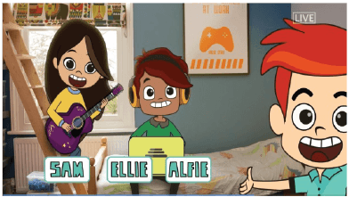
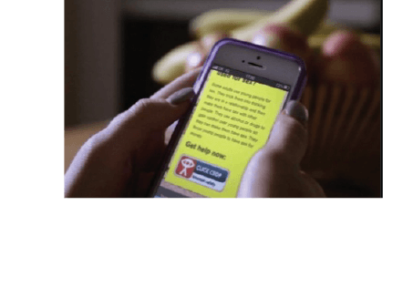
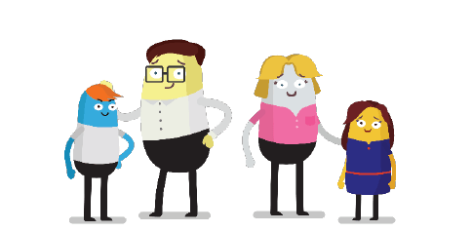

What is Thinkuknow?
Thinkuknow is the education programme provided by CEOP (Child Exploitation and Online Protection).
Thinkuknow offers resources for different audiences:
4-7
8-10
11-13
14+
Parents and Carers
Resources for those with special educational needs and disabilities (SEND)
Visit www.thinkuknow.co.uk for information and advice
Notes:
What is Thinkuknow?
Thinkuknow is the national education programme created by the CEOP Education Team at the National Crime Agency . The National Crime Agency is committed to protecting the public from serious and organised crime, and CEOP's role is to tackle the sexual abuse and exploitation of children both online and offline.
The Thinkuknow education programme aims to empower and protect children and young people from sexual abuse and exploitation.
Thinkuknow provides professionals with the resources to teach children and young people, aged 4 -18, about important online safety and relationships education topics that help keep children safe from sexual abuse online. The Thinkuknow programme includes films, animations, websites, presentations, and lesson plans which help professionals explore difficult and sensitive issues safely with children and young people.
We have also created information and advice for parents and carers to help build their confidence and knowledge in protecting their children online.
In addition to providing professionals with resources there is information and advice for parents and carers to help build their confidence and knowledge in protecting their children online. Thinkuknow also offers expert advice to parents and carers supporting children who are victims of sexual abuse and exploitation.
This presentation is part of the Thinkuknow package for parents and carers.

Slide 6
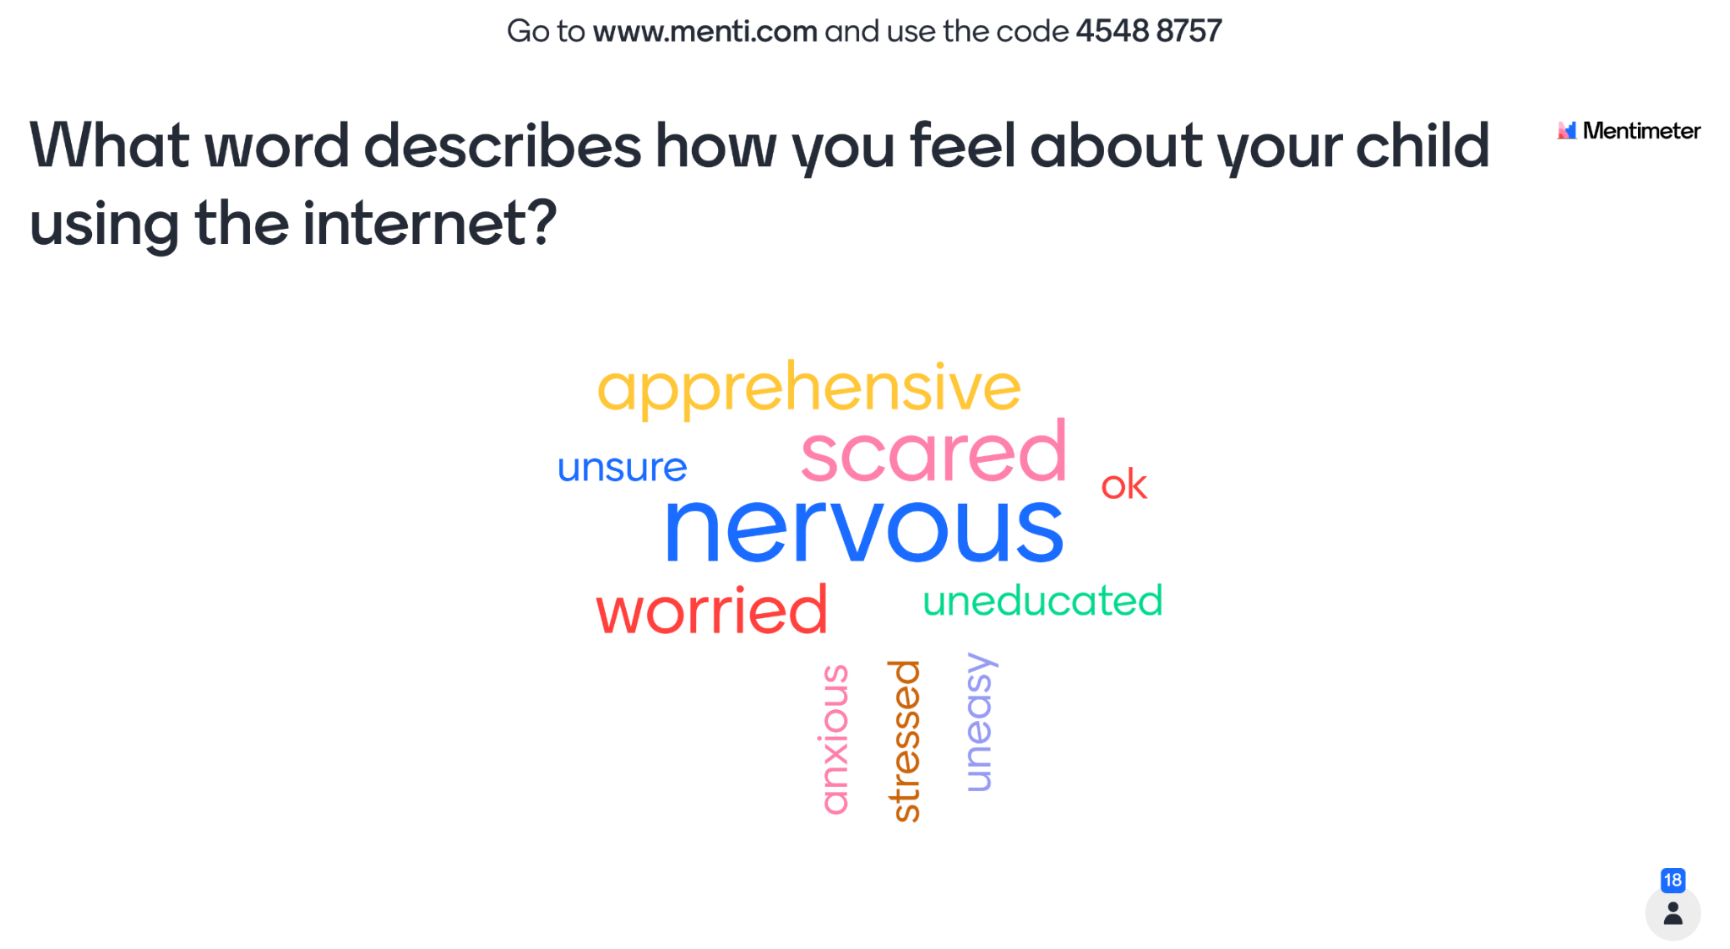

Slide 7




Understanding apps, sites and games
Sharing
Chatting
Viewing
Friending
Notes:
Parents and carers have told us that they can feel overwhelmed by the internet. The emergence of new apps and games every day can make the internet feel vast and ever-changing.
But the reality is, that there are actually only a limited number of functions that sites, apps and games can have.
We recommend using a simple technique of breaking down an app into its key functions of ‘Viewing, Sharing, Chatting, Friending’, and asking some simple questions in order to gain a better understanding of how the app or game works.
This will help you to focus on the safety messages you give your child, based on what they are using.
Let’s take a look at these in more detail.

Slide 8
Understanding apps, sites and games
Anyone can post and share content
There may be inappropriate, sexual or violent content online
Most apps and games include privacy and security settings
Parental controls and filters can also help manage what they see
Viewing
Notes:
The internet provides lots of opportunities for young people to learn and gain information and support, but it is a public and open place, one where anybody can post and share content.
Unfortunately, it can be easy for children to come across inappropriate, sexual or violent content online. Most apps and games (but not all) include privacy and security settings that allow you to control what content can be seen and shared.
In addition, tools such as parental controls and filters can help to manage a child’s online activities and what they are exposed to. Remember, however, these are never totally guaranteed, and as children get older, they may not want filters and parental controls to be used. Therefore, what is vital is open and ongoing conversations with them about what they see online and making sure they are that they can talk to an adult if they see anything online that upsets them.
So ask yourself : What content can they see? Is it age appropriate? What filtering/privacy settings can be utilised?

Slide 9
Understanding apps, sites and games
Sharing pictures and videos can be fun and creative and it helps young people to express themselves.
It’s easy to share online
Young people should never feel pressurised, uncomfortable or blackmailed
Look out for others by not sharing inappropriate content
Sharing
Notes:
A key part of our education with children is talking to them about what they share online. Sharing pictures and videos can be fun and creative and it helps them to express themselves.
But it’s easy to share things online that we wouldn’t face-to-face and it’s important to talk to children about safe sharing.
With older children it’s important we explore the motivations to share online. An image or video should never be shared if they feel pressured, uncomfortable or blackmailed.
We also want to encourage young people to look out for others by not sharing inappropriate content.
So ask: What are they sharing and who are they sharing it with?

Slide 10
Understanding apps, sites and games
Chatting and meeting new people can be fun and appealing
Most people just want to chat or be friends, but some seek to harm
Advise them not to share too much personal information
Talk to a trusted adult if anything worries them
Chatting
Friending
Notes:
Chatting and meeting new people on the internet can be fun and appealing for young people. There are lots of online apps and communities that can be educational and supportive for them, however this also opens up the opportunities for adults to contact them online.
No matter how old your child is, if they are using a device that has the internet - it is important to talk to them about the people who contact them online. Some people online genuinely just want to chat or be friends, but others may put pressure on children or manipulate them into doing something they don’t want to do and it’s important to speak to your child openly and honestly about this.
Young people should always be advised not share too much personal information online, and never feel pressured to do something online that they don’t want to do.
Sometimes children may find it difficult to tell you if something is worrying them online. They may be embarrassed or think that you won’t understand because you don’t ‘get’ their online lives. Other times they may have initiated the contact so they feel they are responsible, or have been told they are responsible for what has happened.
Therefore it is vital that they know that they can talk to a you, or another trusted adult if anything bothers or worries them.
So ask: Who are they friends with and what are they sharing with them?

Slide 11
Understanding apps, sites and games
Sharing
What can you share?
Chatting
Who can you talk to? How? Where?
Viewing
What kinds of content do you see?
Friending
Who can you be friends with?
Notes:
Lets recap.
If your child is using an app, site or game and you want to know more about it you can explore together and ask:
What content can they see?
What can they share and who can they share it with?
Who can they chat with? How and where?
Who can they be friends with?
If you need some help with starting a conversation, here are three ways you can approach it:
I’ve heard that some young people do XXX – what do you think about that?
Has anything ever happened to a friend online that’s worried you?
What things do you do to keep yourself safe online?
Which apps should I be concerned about?
There are no apps, sites or games that are more or less dangerous or risky. People who want to harm children will use any sites or services which children use. Children should know to be wary of people they friend and talk to online, especially if they are asking to talk privately with them, and they should always be advised not share personal information online or any photos or videos that make them feel uncomfortable. Most importantly, it is vital that they know that they can talk to a trusted adult if anything bothers or worries them.

Slide 12
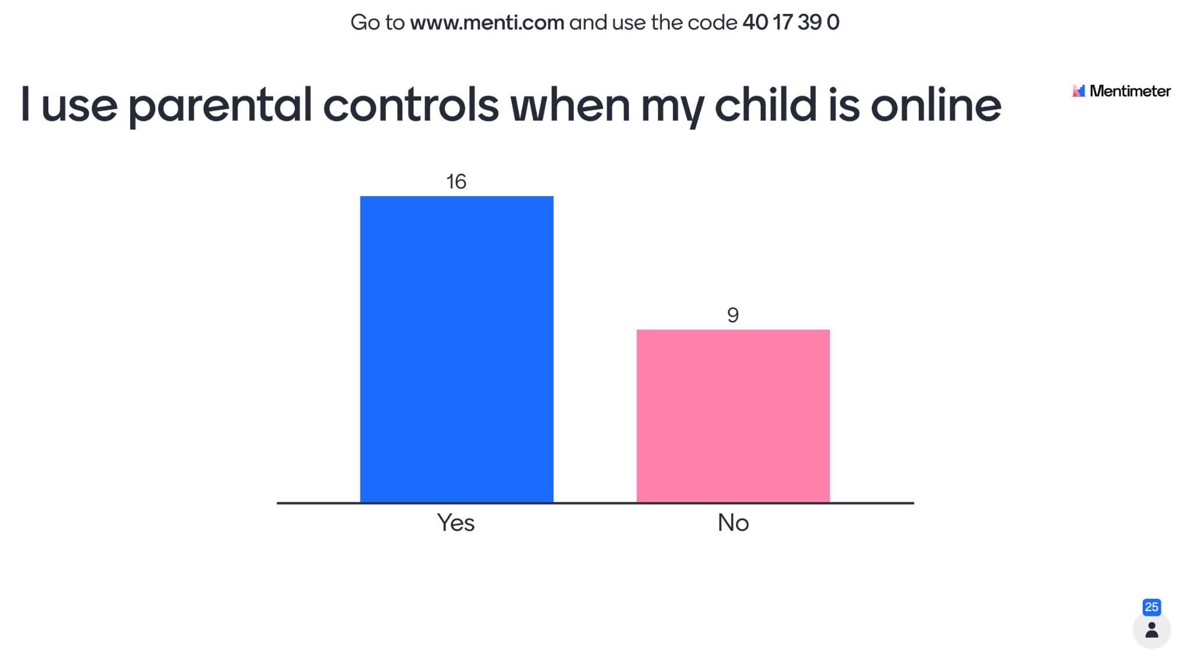

Slide 13
What parental controls are available to use?
Google Family Link - Android
Windows Family - Microsoft
Family Sharing - Apple (not for school iPads)
ScreenGuide - School iPads
There are other paid for parental control apps available

Slide 14

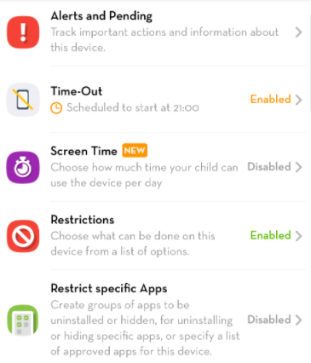
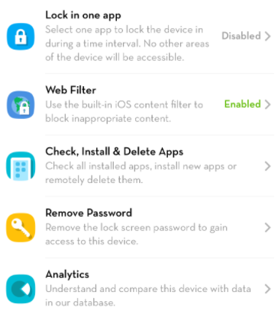
Screen Guide Parental Controls

Slide 15


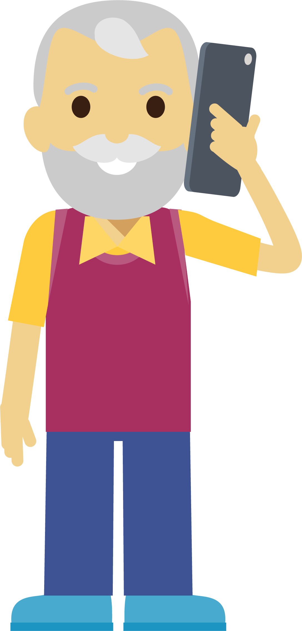





Viewing videos online
www.thinkuknow.co.uk/parents
Notes:
Children and young people love watching videos online. Videos can be entertaining, funny, creative or educational. There are many different types of videos available online – which means your child may see something inappropriate.

Slide 16

Inappropriate video content
The risks
They may, accidently, see something not intended for them
They can be exposed to unsuitable videos through a link they’ve found or been sent, or an app they’ve downloaded
They are curious and they may go looking for content
Notes:
The risks mainly focus on viewing inappropriate content.
What is inappropriate video content? An inappropriate video is anything that worries, scares or upsets your child. It could be aimed at adults and include sexual images or show violent behaviour. Or it might encourage crime, terrorism, eating disorders or suicide and self harm.
How could your child see inappropriate content?
If your child is watching videos online, whether it’s on a streaming service, YouTube or through another platform, they may, accidently, see something not intended for them.
Sometimes, children can be exposed to unsuitable videos through a link they’ve found or been sent, or an app they’ve downloaded.
Sometimes children are curious and they may go looking for content.

Slide 17
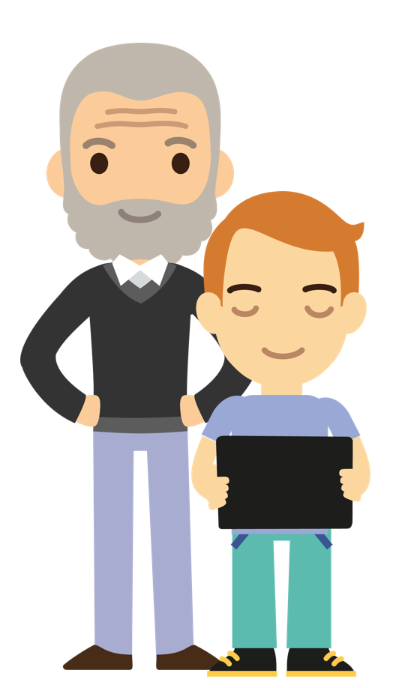
Viewing videos online
What can you do?
Talk to your child - about the videos they like to watch, what makes a video inappropriate and what to do if they see anything they shouldn’t.
Look up the age ratings - before your child uses them for a guide as to whether it’s appropriate.
Set up parental controls and filters - to help you manage the content your child may see.
www.thinkuknow.co.uk/parents/articles/parents-guide-to-watching-videos-online
Notes:
1.Talk to your child
Talk about the videos they like to watch and watch some together, as this will help you to identify if they are suitable for them. Talk about what might make a video inappropriate and make sure they know what to do if they see anything they shouldn’t. Encourage your child to talk to you or another adult they trust if they see anything whilst watching videos that makes them feel worried, scared or sad.
2. Look up the age ratings
Younger children are more likely to come across inappropriate content if they are using apps, websites or services before reaching the minimum age requirements. Check the age ratings or requirements before your child uses them for a guide as to whether it’s appropriate.
3. Set up parental controls and filters
Most apps, sites, games and services have parental controls and filters to help you manage the content your child may see. Some services also let you set up child accounts, so content can be automatically filtered, or you can choose what content your child can view and block any obvious adult content.

Slide 18
Gaming online
www.thinkuknow.co.uk/parents
Notes:
Gaming is a popular with children, young people and adults across the world. Many games have an interactive online element- whether it's playing against others, chatting or making purchases.
For most children and young people, gaming is a fun way to spend time with friends. Gaming creates opportunities to develop teamwork, concentration skills and problem-solving.
While playing games online is often great fun, it's important you understand what risks there are and what measures you can take to protect them while they’re playing their favourite games.

Slide 19
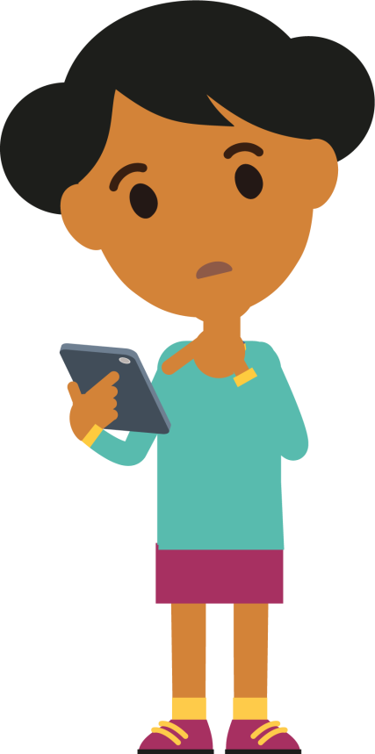
Gaming online
The risks
Chatting with people they don’t know
Inappropriate or unmoderated chat
Requests to chat in private
Offering gifts or trades
Notes:
What are the risks?
•Chatting with people they don’t know. Gaming is different to social networks, as players often play against people they don’t know. This may include adults.
•Inappropriate or unmoderated chat. In some games swearing and insults are common, especially when a player hasn’t performed very well. Mean comments or insults can hurt, and competitive criticism might feel like bullying for some children.
•Requests to chat in private. Once a child moves to private chat, it may not be monitored by the game. They might share personal information or feel pressured to do something that they don’t want to do.
•Offering gifts or trades. Some people may offer to trade – or give – your child in-game items or currencies to earn their trust and persuade them to have a separate conversation outside of the game.

Slide 20


Gaming online
What can you do?
Play with them - to understand how they talk online, who they talk to online and what you’re comfortable with.
Talk to them - about the games they play, who they talk to and how.
Use family controls - to manage, limit or turn off in-game chat.
Encourage reporting – of inappropriate chat in game and anything in the game makes them feel worried or uncomfortable.
www.thinkuknow.co.uk/parents/articles/in-game-chat
Notes:
Play with them . Play, or watch your children play, online games to understand how they talk online, who they talk to online and what you’re comfortable with. Look at the privacy settings together.
Talk to them. With older children, who may not want you to play with them, have regular chats about the games they play, who they talk to and how.
Use family controls. Use family controls and in-game settings to manage, limit or turn off in-game chat to make sure that you’re confident interactions are right for your children.
Encourage reporting. To catch potential problems early, encourage your children to report inappropriate chat in game and to tell you if anything in the game makes them feel worried or uncomfortable.

Slide 21
Sex and relationships online
www.thinkuknow.co.uk/parents

Slide 22


The World Changes. Children Don’t.
Notes:
Insert video file to slide - ‘The World Changes. Children Don’t’
‘The World Changes. Children Don’t’ is a video made by NCA-CEOP for parents and carers. It shows what Shakespeare's story of Romeo and Juliet would look today with the influence of technology in relationships.
The point of the video is to demonstrate that young people haven’t changed, young people are still doing all of the same things adults did when they were young, but in new ways. Social media has changed the way young people communicate but their curiosity about friendships and relationships remains the same. Having a supportive parent or carer can make all the difference in helping children explore these themes as safely as possible.

Slide 23

Sexual exploration online
Exploring friendships online can create opportunities for young people to gain support.
It’s natural for young people to start exploring their sexual feelings online.
Talking to new people online can feel exciting to young people, but they could be contacted by people who pose a risk to them.
Risk-taking is a normal part of growing up.
Notes:
Sexual exploration online
Exploring relationships online can create opportunities for young people to gain support. As parents, it is important to focus on positives as well as any risks
It’s natural for young people to start exploring their sexual feelings online. This is part of their development and young people will use the internet to explore their friendships and relationships.
Talking to new people online can feel exciting to young people, but they could be contacted by people who pose a risk to them. It is important to talk to young people about staying safe when chatting online. There is advice on how to have these conversations at thinkuknow.co.uk/parents
Remember, adolescents are more inclined to take risks - this is a normal part of growing up. They might be even more likely to take risks online as being online may give them the confidence to do and say things they might think twice about ‘in real life’. It is important to understand this and to talk to your child in a positive way, helping them to learn, explore and develop their identity online in a safe way.

Slide 24


Sexual exploration online
“I think a lot of difficult conversations can be easier by messaging ‘cos it’s easier to have a bit of time to think…Like, so you’re not really on the spot, you can just have a bit of time to think. And you can stay a bit more calm.”
Young person, 14
“Being able to find people online is, like, an easy way to test the waters. To, like, experiment or to, like, reaffirm your own sexuality and stuff like that.”
Young person, 15
Notes:
Sexual exploration online
The two quotes on the slide are from young people from Brook/NCA-CEOP research ‘Digital Romance’, 2017
Talking about relationships and the internet with your children can feel daunting, but it is important to remain balanced and communicate that you understand.
Technology has become such an integral part of young people’s love lives, and young people have said they want adults to understand the positive role it can play in love and relationships.
Young people have said they are less likely to go to their parents for advice if they feel their parents only portray a negative and risky role of the internet in relationships.
Thinkuknow has a lots of advice and resources to help parents and carers have these conversations.
Recommend that parents and carers visit www.thinkuknow.co.uk/parents to read advice on how to support their child online.

Slide 25
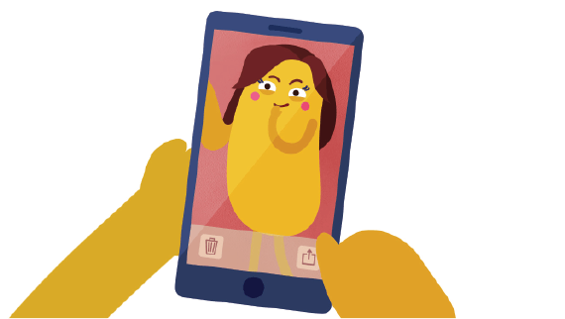
Sharing images
Young people may share naked or semi-naked images of themselves for a variety of reasons:
As part of a committed and trusting relationship
To fit in with friends that may be doing the same thing.
Because they are looking for reassurance about body image.
For fun or humour within a peer group.
Because they have been pressured into doing so by another person.
Notes:
Sharing of images
The slide details a range of contexts and motivations in which a young person may share a naked/semi-naked photo of themselves online.
‘Nude image sharing’ is a term used to describe naked or semi-naked pictures or videos taken on an electronic device and shared online. Young people often refer to nude pictures as either ‘nudes’ or simply ‘pics’.
Young people may share naked or semi-naked pictures of themselves for a variety of reasons. This can be a positive experience if done safely and consensually, but of course it can also expose them to risks.
These motivations demonstrate a range of situations and contexts in which a nude photo may be taken. Some situations are more risky than others, and show how important it is to understand the context behind an image.

Slide 26

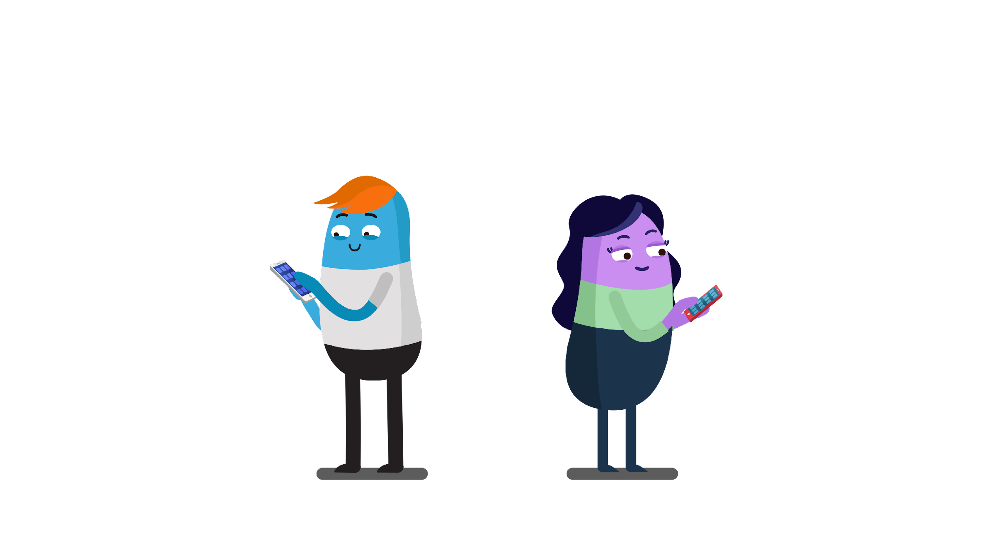
Talking to your child about sharing images
Talking to your child about relationships, sex and nude images is the best thing that you can do to help keep them safe.
Avoid appearing judgemental, or saying ‘don’t do it’
Even when nude images are shared with trusted friends and partners, there's a chance that more people could end up seeing them
Discuss what a healthy relationship looks like, including the importance of trust and consent
Remind them that no one should be pressured into sharing a nude image if they don’t want to.
Notes:
Talking to your child about relationships, sex and nude images is the best thing that you can do to help keep them safe. Avoid appearing judgemental, or saying ‘don’t do it’ without opening up a conversation about it first. They are less likely to open up or come to you for help if they need it, if they think you are judging them.
Consider starting off with an example from a TV programme or an article about a celebrity who shared a nude image or ask them if its something young people do – distancing the conversation gives them the opportunity to share their opinions without sharing personal details first.
Explain that even when nude images are shared with trusted friends and partners, there's a chance that more people could end up seeing them. Discuss what a healthy relationship looks like, including the importance of trust and consent.
Remind them that no one should be pressured into sharing a nude image if they don’t want to. If someone says no to sending one, this decision should be respected.
It’s also not OK to share nude images without someone’s consent and it’s ok to tell someone. Young people often think once they’ve sent an image, they’re powerless to prevent anything bad from happening.
If your child is worried about an image they’ve shared, there are things you can both do about the situation, including reporting to NCA-CEOP.
Visit the www.thinkuknow.co.uk/parents for more information.

Slide 27
Sexual abuse online
www.thinkuknow.co.uk/parents

Slide 28
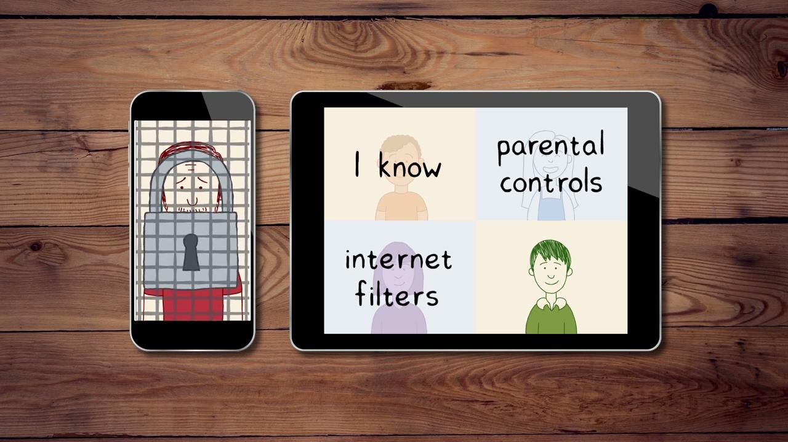
#WhoisSAM?
Notes:
Optional video – please watch before delivery. It is at your discretion whether you would like to include.
Insert video file to slide – WhoIsSam?
Before watching the video
I am going to show you a short animation which is narrated by a fictional character called Sam. Sam is an online offender who targets children online and quickly builds trust with them.
After watching the video.
Firstly, online offenders can be anyone. There is not just one ‘type’ of person, as shown in this video. All children can be vulnerable and it is very important we do not approach this from a perspective of ‘it won’t happen to someone I know’.
What is important, is that you, as parents and carers talk openly to your children about being safe online, about healthy relationships and encouraging them to speak out if anything happens online that worries them or doesn’t feel right.

Slide 29

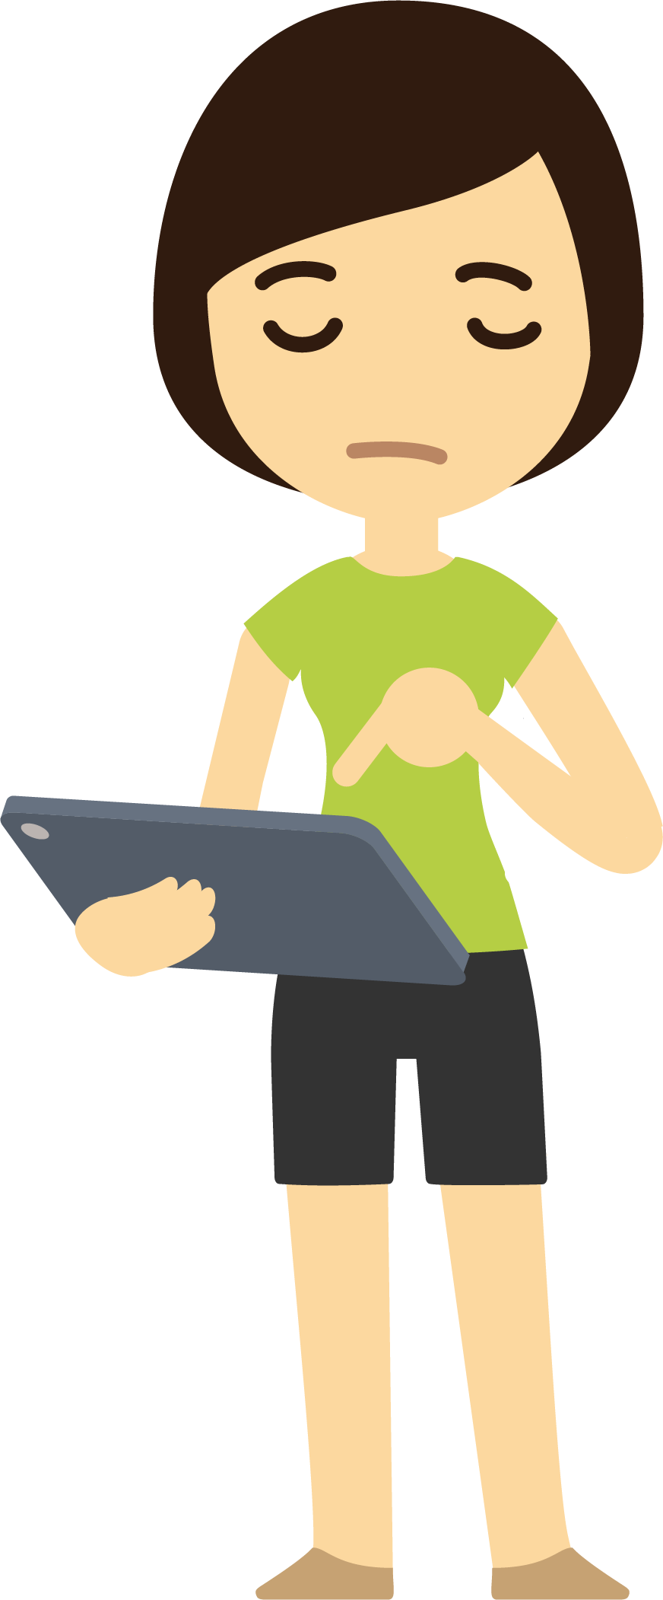
Sexual abuse online
There are opportunities for adults to contact children and young people online, in order to harm them. They can use any part of the internet including games, social media, live streaming platforms.
Adults can create multiple online identities and even pretend to be children and young people themselves.
Adults can exploit young people’s natural curiosity by talking about sex and introducing harmful things.
Adults can pressure, intimidate and coerce children into doing things that they are not ready for. Increasingly children and young people are tricked into sexual activity over live video.
Notes:
Sexual abuse online
There are opportunities for adults to contact children and young people online. They can use any part of the internet including games, social media, and live streaming platforms. They may send out multiple ‘friend requests’ or messages at random, target young people who they identify as particularly vulnerable (for example, by the things they post online) or may attempt to build a relationship via a game.
Adults can create multiple online identities and even pretend to be children and young people themselves. Others may be open and honest about who they are.
Adults can exploit young people’s natural curiosity by talking about sex and introducing harmful things. They may start with seemingly ‘innocent’ comments and build up to more sexual conversation and sending images and videos.
Adults can pressure, intimidate and coerce children into doing things that they are not ready for. Increasingly children and young people are tricked into sexual activity over live video. Talk to your child and ask them what they would do if someone made an inappropriate request online, give them the skills to respond and make sure they know that they can come to you.
Make sure they know who they can report to . If your child shared a picture or video because they were threatened, pressured, or forced to, or you believe your child is being groomed or is at risk of sexual abuse you should report to CEOP. CEOP can help protect your child. It’s never too late to get help.
We will tell you how to do this at the end of this presentation

Slide 30
What can you do?
www.thinkuknow.co.uk/parents

Slide 31

Chat little and often
Talk to your child about their life online
Take the opportunity to talk to them about how they stay safe
Are their friends online people they have met in the real world?
If they are introduced to a new contact through a friend, can their friend verify their identity?
Explain any worries you may have
Notes:
What can you do to keep your child safe online?
Chat little and often
The best way you can protect your child is to establish a positive relationship with them around their life online. Talk to them – not just once but have ongoing conversations as part of your family life.
Ask them what they are doing online, and what they like and dislike about the apps and services they use. Take the opportunity to talk to them about how to stay safe on these services and in general. For example, you could ask about the types of issues that have arisen for their friends online, and what advice they would offer to help them feel safe. Talking about others, can help you avoid directly questioning what they do online, and possible embarrassment.
Explain to them any worries you have. Your child might think that you are getting worried for no good reason, but if you explain why something is troubling you they will understand why you want to talk to them. Tell them if it is something you have read about or seen their friends doing.

Slide 32

Report anything that worries them
Make sure they know they can come to you
Help them identify trusted adults
Let them know you won’t blame them
Direct your child to age appropriate information
Notes:
Remind them to report anything worrying, and how they can do this
It’s important that children and young people always know where to go if they come across something that worries them or makes them feel uncomfortable online.
To help, you could, encourage them to speak to you or another adult immediately if they have any worries or concerns. Help them to identify a trusted adult that they can approach, if they feel they can’t talk to you, even if this means on the phone.
Make sure they know that they can always report to CEOP if they are worried about sexual abuse online. Or if they are worried about something else, they can call a helpline, like Childline. We tell you more about this at the end.
Make sure they know that you would never blame them for anything that might happen online. Technology, flirtation, excitement and hormones are a powerful mix. This can make it hard for young people to think clearly about their actions online and to consider the possible consequences. Young people will take risks online, and they need to know that you will always give them calm and non-judgemental support.

Slide 33
Thinkuknow resources
www.thinkuknow.co.uk/parents
Notes:
Explore the Thinkuknow resources together
The Thinkuknow films and activities are a great way to start and continue chats about online safety.
We also have our Thinkuknow websites for children and parents and carers.

Slide 34
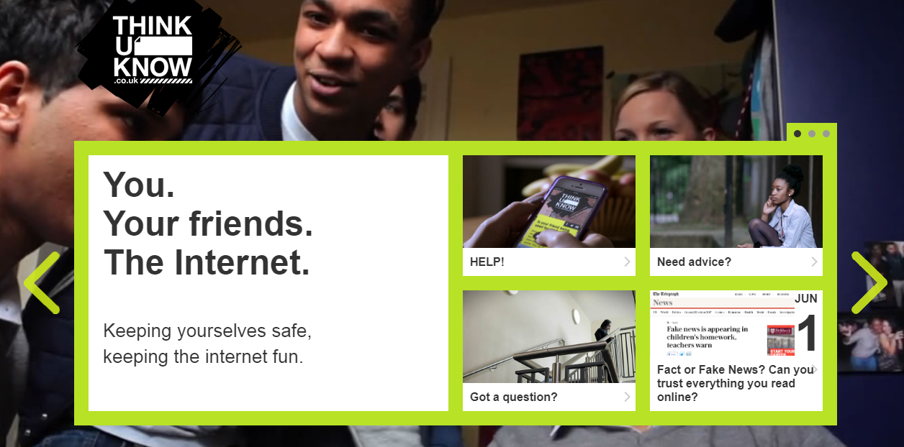
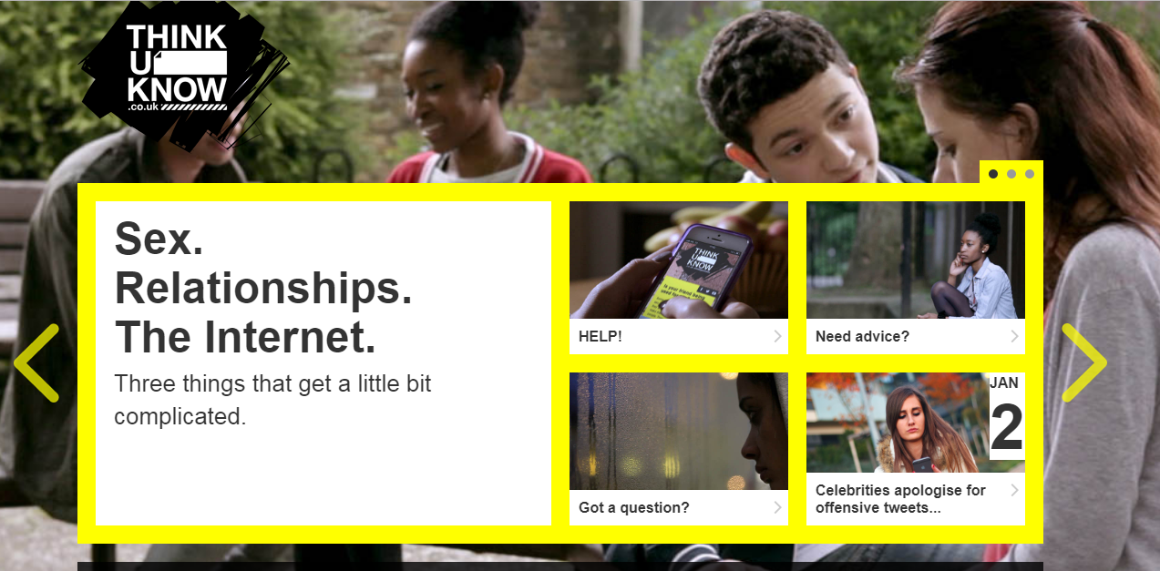
Thinkuknow teen websites
Notes:
There are two teen Thinkuknow websites. One for 11-13 year olds and one for 14+. The websites help young people to develop healthy approaches to friendships, relationships and the internet.
It teaches them to identify negative or unhealthy behaviour, respond with resilience, and know where to go for help if they ever feel anxious or threatened online or in a relationship. They cover topics such as: consent, healthy and unhealthy relationships, pressurising and threatening behaviours online, and reporting abuse to NCA-CEOP.
Encourage parents to take a look at the teen websites following the session and using them to start a conversation with their teenager.

Slide 35
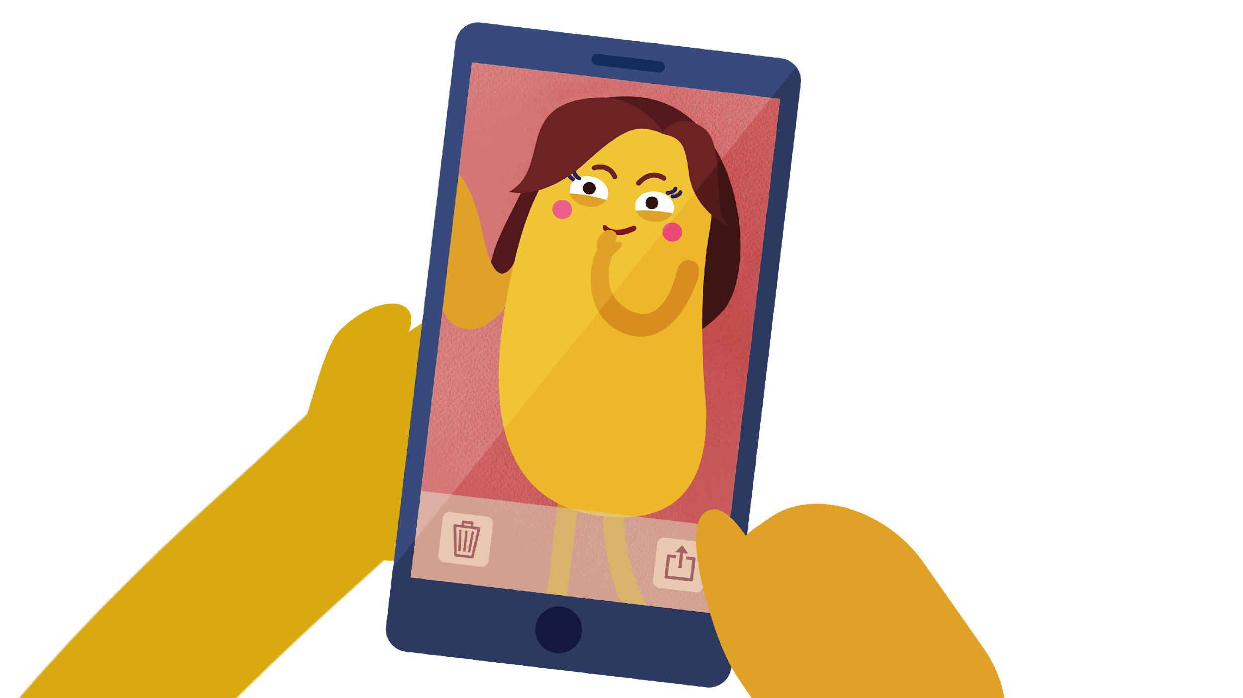
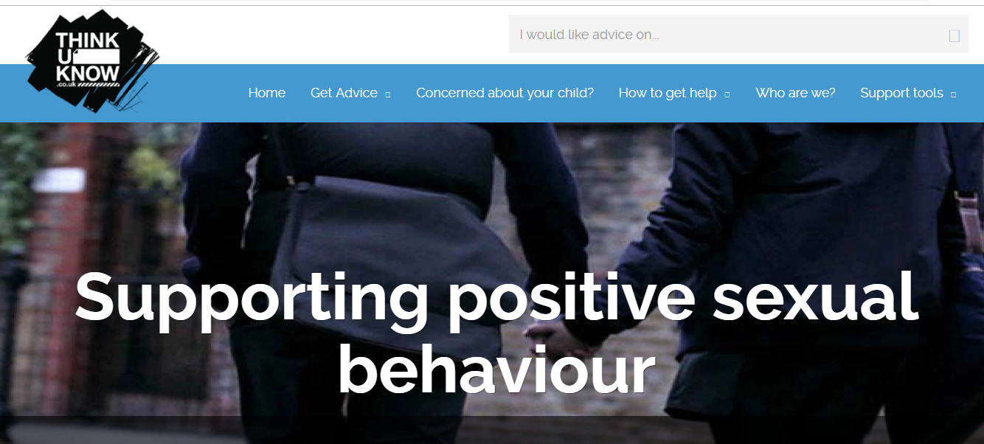
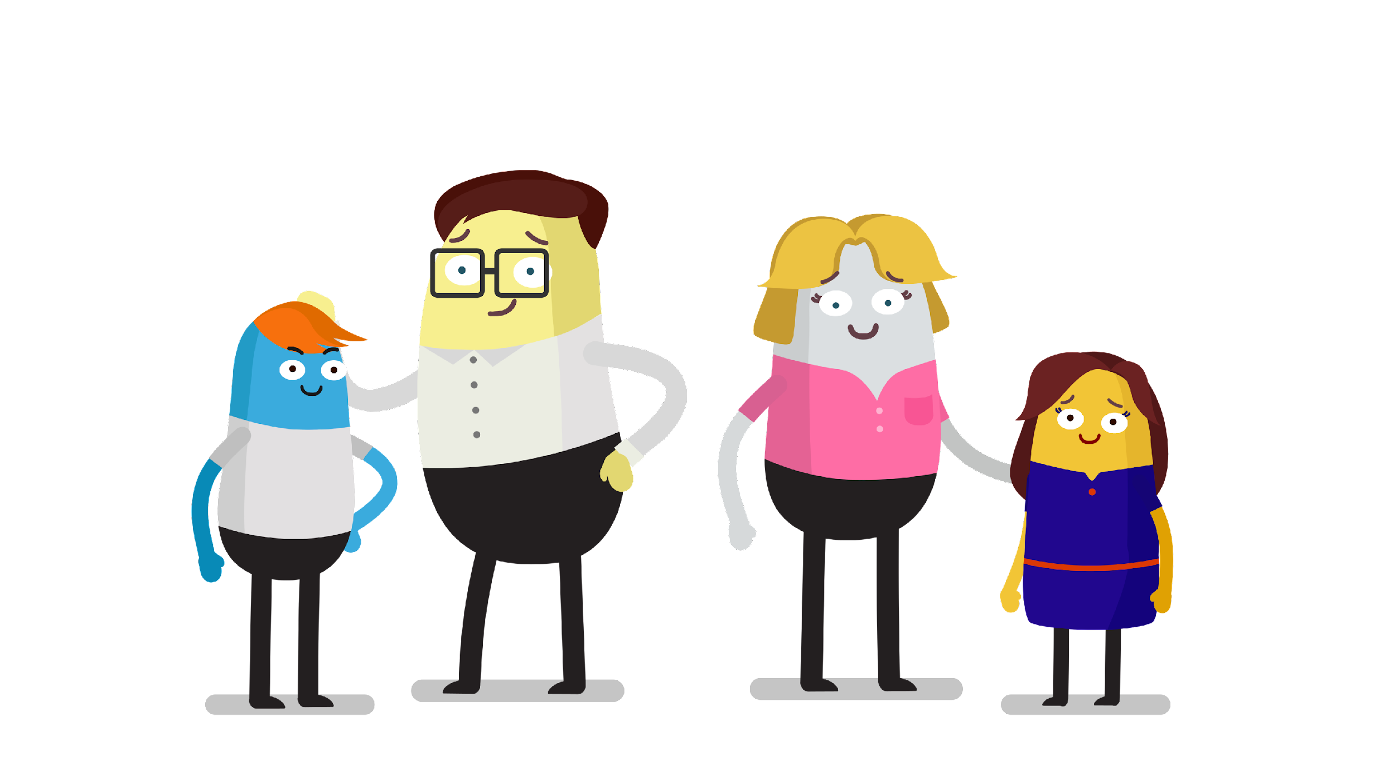
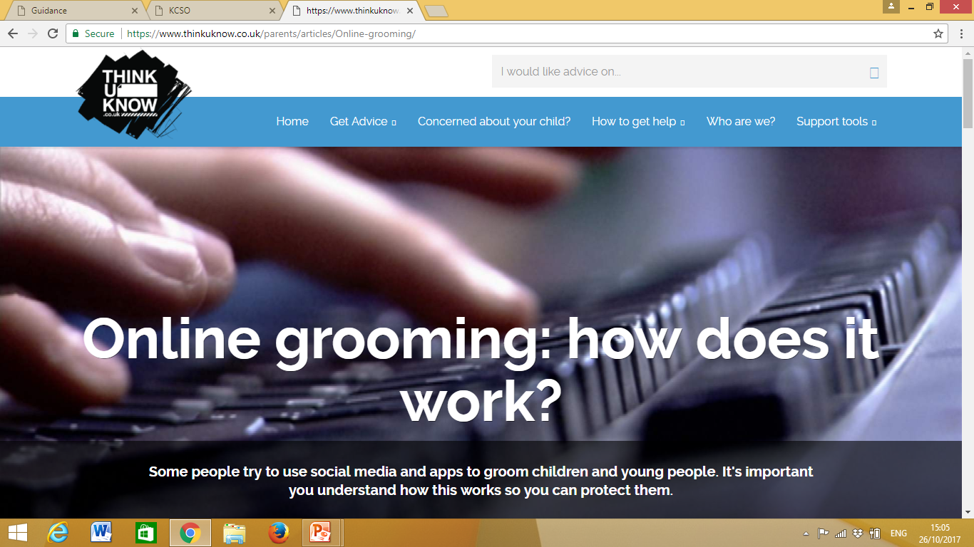
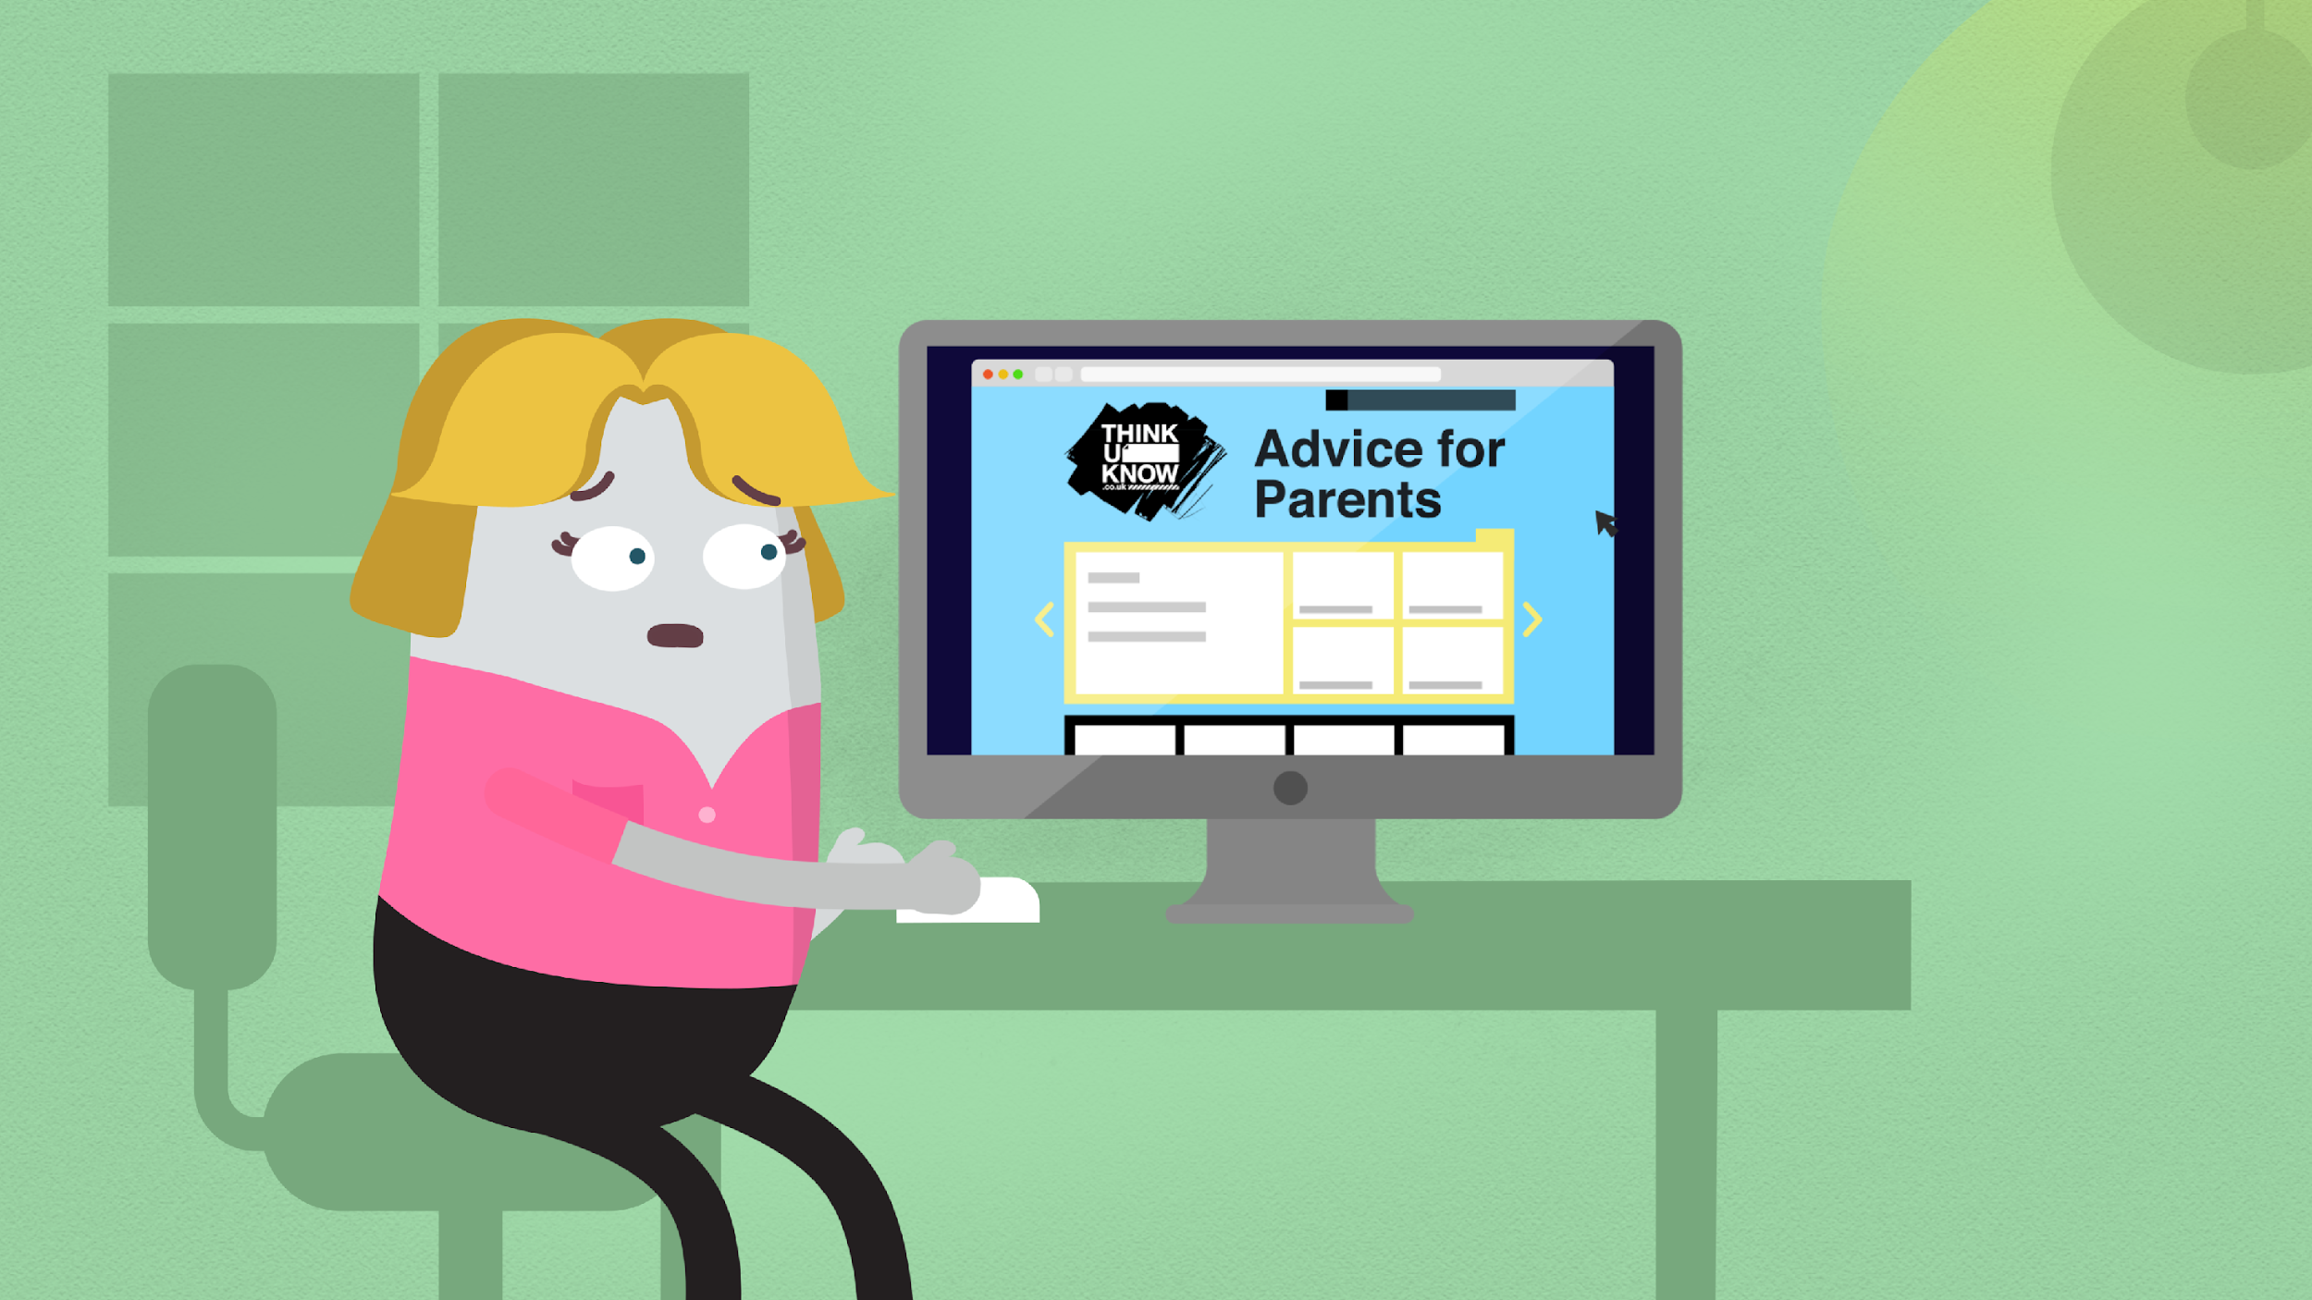
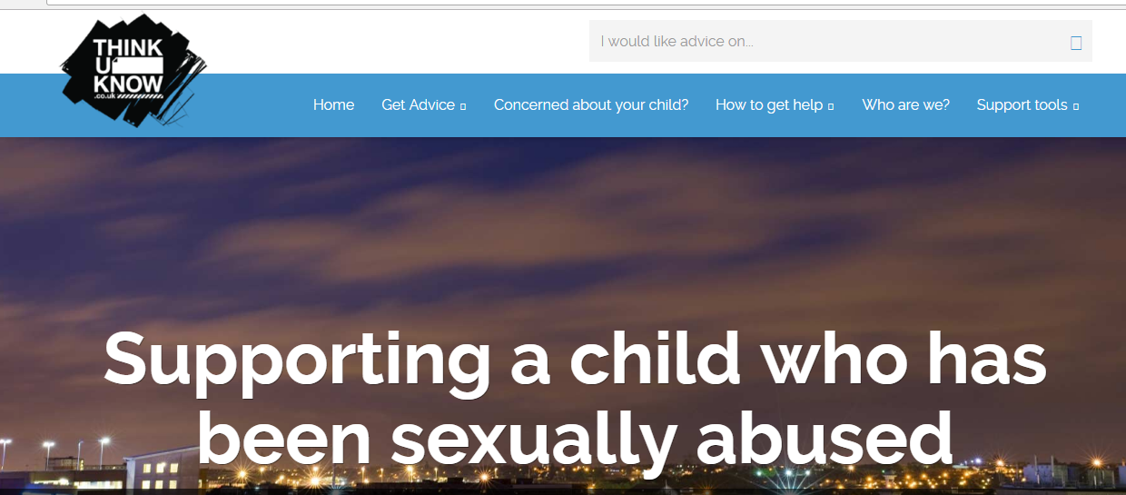
Resources for Parents and Carers
Notes:
Resources for parents and carers
Nude Selfies: What Parents and Carers Need to Know is a series of three animated films for parents and carers. The films offer advice on how to keep children safe from the risks associated with the sharing of nude and nearly nude images. The films cover young people's motivations for sending nude images, responding constructively to an incident in which a child has shared a nude image, and identifying risky behaviours or situations.
Encourage parents to watch these on YouTube following the session.
Include one of the films here if you have the time.
Thinkuknow Parents and Carers website - The Thinkuknow Parents and Carers website contains a wealth of information and advice for parents and carers on keeping their children safe online. The website covers topics such as: having a conversation with your child, using parental controls, understanding live streaming and supporting children who have been sexually abused. It is divided into three sections:
I need to report an incident – for information and support when something has already happened to a child or young person
I’m concerned about my child – for information and support when there are concerns about a child or young person
I’d like to understand more about keeping my child safe – for preventative information and advice on keeping children safe online

Slide 36
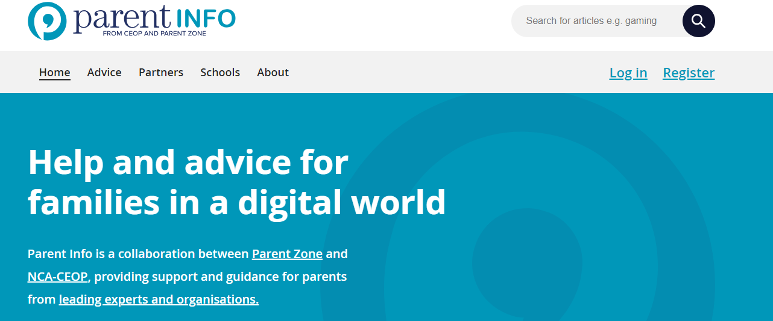

www.parentinfo.org
Notes:
Parent info
Parent Info is a partnership project between NCA-CEOP and the parent organisation Parent Zone.
It’s a website and advice service for parents and carers, which aims to build the resilience of their children through articles, tips and advice. Articles are written by expert organisations on a range of different topics, all linked by the internet. The website is divided into the following categories:
Games, apps and tech
Parenting
Safety and settings
Relationships and sex
Education and the future
Health and wellbeing

Slide 37

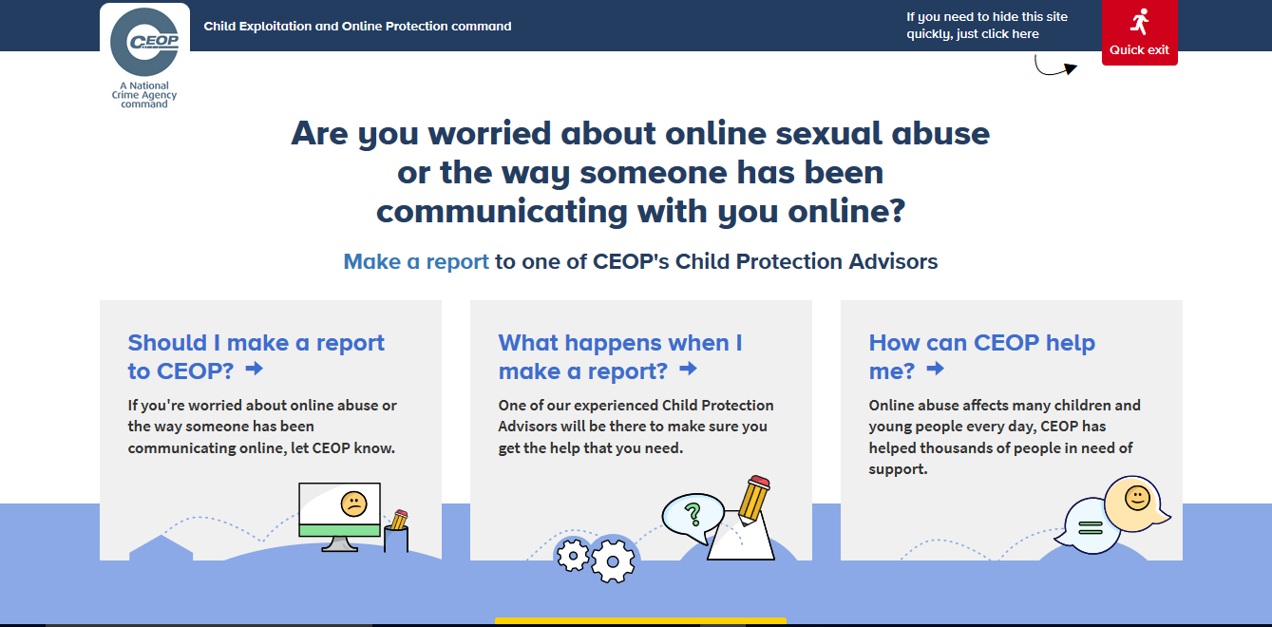
Reporting to NCA-CEOP – www.ceop.police.uk
Notes:
Note to presenter: Before delivering this section, familiarise yourself with NCA-CEOP’s website and advice pages by visiting www.ceop.police.uk.The website has information on:
When to report to NCA-CEOP
What happens when a report is made to NCA-CEOP
How NCA-CEOP can help
You can have the ClickCEOP button embedded in your organisation’s website to provide children and young people with easier access to the reporting form. Contact us at ceopeducation@nca.gov.uk to find out more.
CEOP is part of the National Crime Agency, a law enforcement agency. The NCA-CEOP website hosts an online reporting tool, made specifically for children and young people in order for them to report concerns related to online sexual abuse and exploitation. Before accessing the reporting form, information is available on the types of reports CEOP receive and what happens following a report.
CEOP reporting is designed specifically for children, so that they always have somewhere to go if they are worried. The reporting form is designed to be as accessible as possible by children, but it is highly recommended that young children of primary school age seek the support of an adult they trust to help them make a report.
It is not possible to report to NCA-CEOP anonymously. NCA-CEOP advise any urgent reports where a child is in immediate danger should be reported to the local police force where the child is located.

Slide 38



Other organisations who can support
Notes:
Remember, it’s important that children and young people always know where to go if they come across something that worries them or makes them feel uncomfortable online.
Let them know there are organisations they can talk to, if they don’t feel able to talk to you or another trusted adult.
Childline is a confidential 24/7 counselling service run by the NSPCC for all children up to the age of 19. Children can speak to a trained counsellor on the phone or online about any issue that they are going through – www.childline.org.uk
Childline also have a Report Remove service, which allows children and young people under 18 to report a nude image or video of themselves that might have been shared online, and get it removed from the internet.
The Mix is another confidential helpline and support service for young people under the age of 25. The Mix specialises in topics such as sex and relationships, homelessness, drugs, mental health and finding a job. Get more information at www.themix.org.uk

Slide 39
Chat little and often
Talk to your child about their life online
Take the opportunity to talk to them about how they stay safe
Explain any worries you may have
Report anything that worries them
Make sure they know they can come to you
Help them identify trusted adults
Let them know you won’t blame them
Direct your child to age appropriate information
Notes:
Before you go, here’s a quick recap on what you can do, to help your child stay safe online.

Slide 40




Staying up to date:
@CEOPUK
ClickCEOP
www.thinkuknow.co.uk
www.thinkuknow.co.uk/parents
www.ceop.police.uk/safety-centre
Notes:
Thank you for taking the time to join us today.
For more information on any of the resources we have talked about, reporting or further advice and guidance please visit our website – www.thinkuknow.co.uk/parents
The NCA-CEOP ‘safety centre’ and reporting tool can be found at www.ceop.police.uk
You can also keep up to date by following NCA-CEOP on Twitter or Facebook.

Slide 41

Any Questions?

